Slide 1







FROM PAGE TO SCREEN
THE INFLUENCE OF BOOK ADAPTATIONS ON MOVIE SUCCESS
Andreia Jardim

Slide 2


Content
Introduction
Technical Developments
Product Showcase
Conclusions

Slide 3


Introduction
The movie industry is a multi-million dollar industry and a key form of entertainment.
For movie directors, the decision of whether to adapt a book or create an original screenplay is crucial and can greatly impact a movie's success.
GOAL: Understand the differences between book adaptations and original screenplay to help directors to make informed decisions that maximize the chances of creating successful movies.

Slide 4



Key Questions
Does basing a movie on a book lead to higher financial success?
Are there differences in ratings and popularity between book adaptations and movies with original screenplays?
How can data analytics assist movie directors in making informed decisions?

Slide 5



Technical Developments
Data Collection
Numbers website - Using Selenium
List of the most profitable movies of all time that are original screenplay.
List of the most profitable movies of all time based on books.
IMDB website - Using Selenium
Built the search URL with each movie name for both dataframes (original screenplay and books).
Get Rating and Votes (popularity) for both dataframes.
Merge data from both websites to get the 2 final dataframes: original screenplay and books.

Slide 6

Technical Developments
Hypothesis Testing - Average Gross
Hypothesis statement:
H0: The average gross revenue between movies based on books and movies based on original screenplay is equal.
H1: The average gross revenue between movies based on books and movies based on original screenplay is not equal.
Result:
T-statistic: 2.4525
P-value: 0.0172
Conclusion:
Reject the null hypothesis: p-value (0.0172) is less than the significance level of 5%

Slide 7
Technical Developments
Hypothesis Testing - Average Rating
Hypothesis statement:
H0: The average rating between movies based on books and movies based on original screenplay is equal.
H1: The average rating between movies based on books and movies based on original screenplay is not equal.
Result:
T-statistic: 0.0154
P-value: 0.9877
Conclusion:
No sufficient evidence to reject the null hypothesis: p-value (0.9877) is much higher than the significance level of 5%

Slide 8
Technical Developments
Hypothesis Testing - Average Votes (Popularity)
Hypothesis statement:
H0: The average number of votes between movies based on books and movies based on original screenplay is equal.
H1: The average number of votes between movies based on books and movies based on original screenplay is not equal.
Result:
T-statistic: -1.2110
P-value: 0.2308
Conclusion:
No sufficient evidence to reject the null hypothesis: p-value (0.2308) is higher than the significance level of 5%

Slide 9



Hypothesis Testing Key Findings
Original screenplay movies have a greater potential for financial success in the movie industry.
The quality or appeal of a movie, as reflected by ratings, is not influenced by whether it is based on a book or has an original screenplay.
The analysis also revealed that both sets of movies may have a similar level of popularity among audiences.

Slide 10




Technical Developments
Power BI Dashboard
Database: Based on book dataset (zenodo.com)
Ratings: Provide directors with ratings for the books, allowing them to assess the critical reception of a movie adaptation, ensuring they choose books with favorable ratings.
Popularity: Directors can prioritize books that received a high number of votes, indicating a strong fan base and potential built-in audience for the movie adaptation.
Understand the level of engagement and interest the books generated among readers and potential moviegoers.
Directors can make data-driven decisions and select books that align with their goals, increasing the chances of producing successful movies.

Slide 11

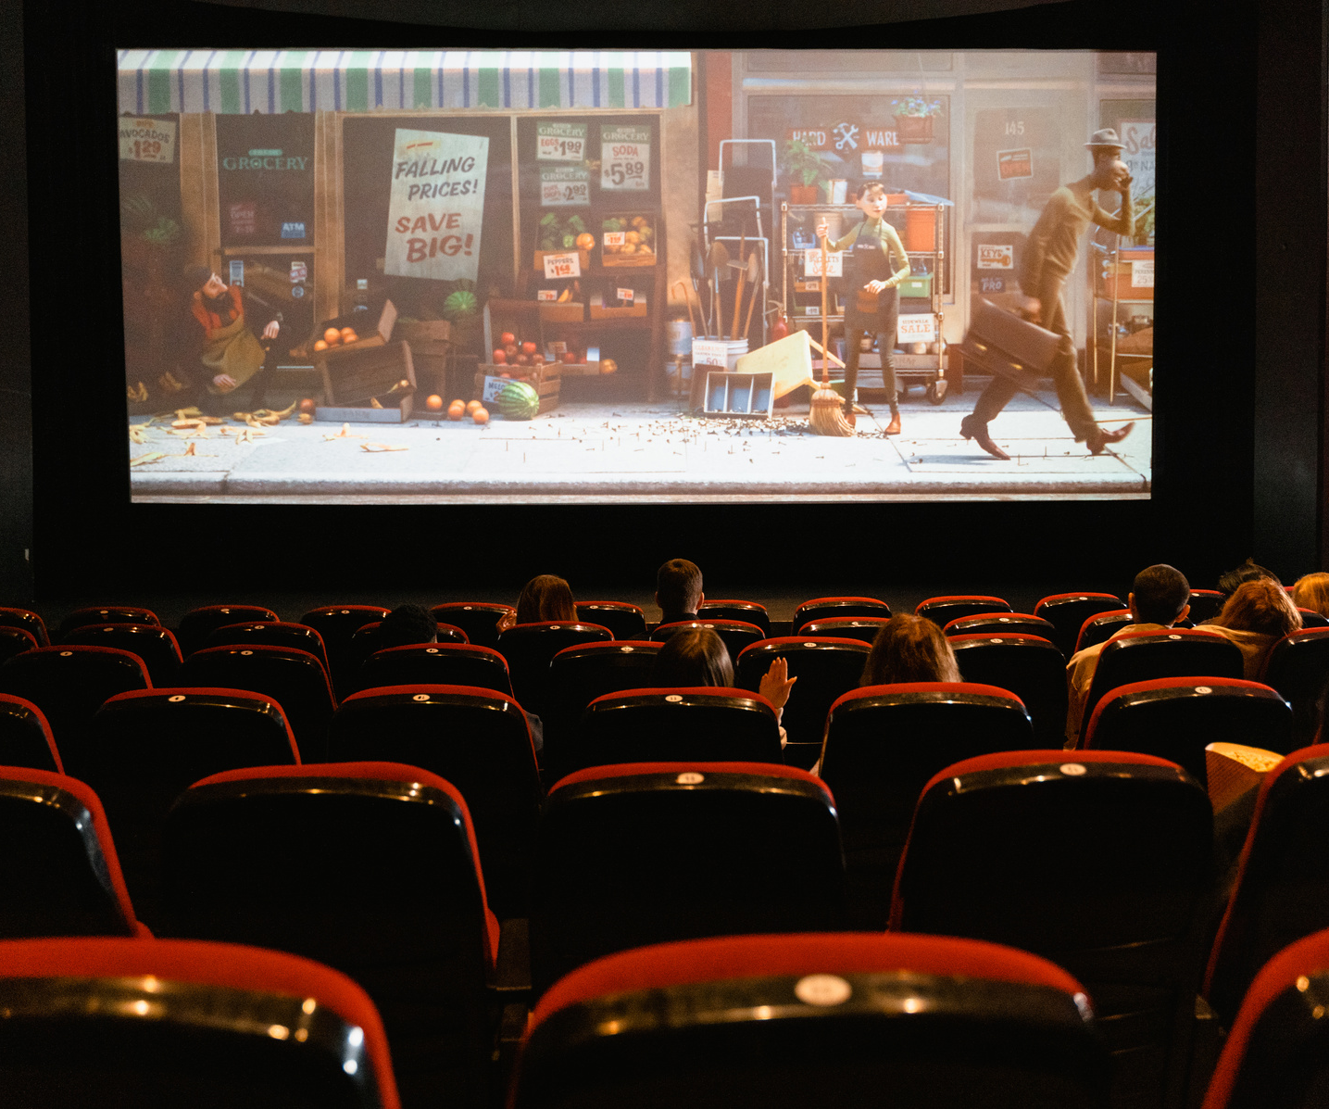


Conclusions
By leveraging data analytics, movie directors can increase their chances of success by making informed decisions based on key insights from the analysis.
Future improvements include expanding the dataset, incorporate additional variables and AI movie scipt generator.

Slide 12



THE END

